Slide 1
The History of Operating Systems
Martita De La Fuente

Slide 2
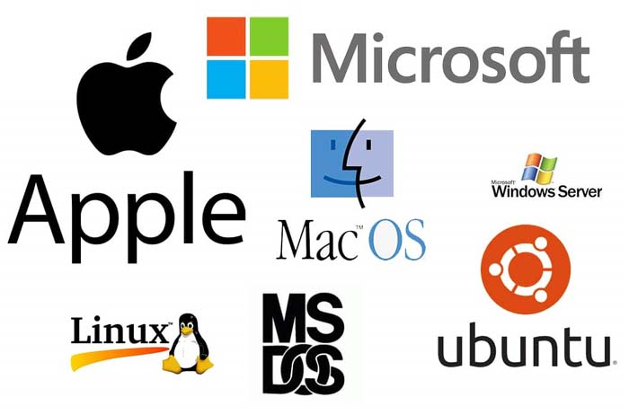
What is an Operating System?
Is the software that controls the overall operation of a computer.
Operating systems make it easier for a user to run a program and communicate with the software.
It provides the means by which a user can store and retrieve files.
Without an operating system, a user cannot run any application.
It plays a very crucial role in our computers.
Best known examples of an operating systems :
Windows
Linux
macOS

Slide 3
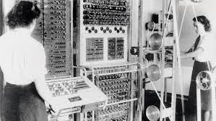
First Generation
Today’s operating systems are large , complex software packages that have grown from humble beginnings.
The First generation (1945-1955) only had computer systems that were used to perform simple mathematical operations and also electronic computers were introduced during the 1940’s.
To control the machine functions plug boards were used using the wiring.
The Execution of each program is called a job.

Slide 4
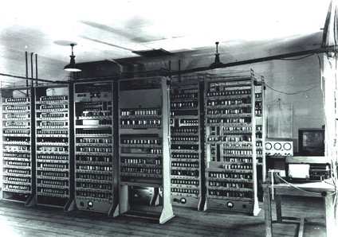
Second Generation
(1955-1965) General Motos Operating System was the first operating system that came into the picture in the 1950’s which was developed for IBM Computers.
IBM was the first one that bought an operating system into the world.
In the second generation, around the 1960s the first UNIX Operating system was developed that was available for free for a few years.
Example:
Type of operating system and Batch OS.

Slide 5
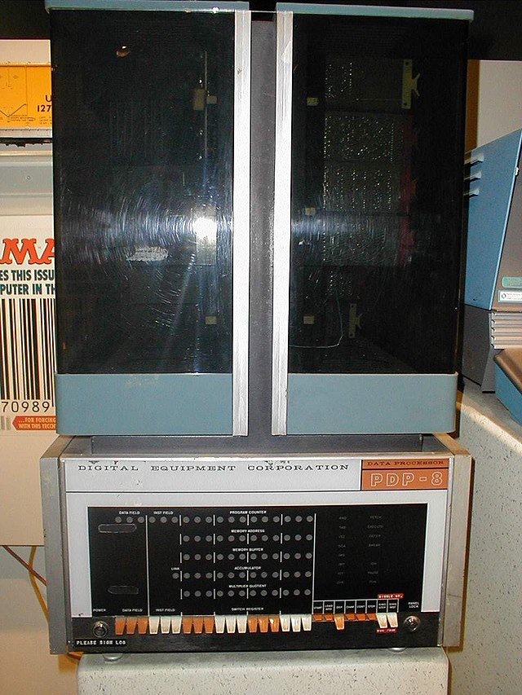
Third Generation
(1965-1980) In the third generation, the concept of multiprogramming was introduced in which multiple tasks could be performed in a single computer.
Example: operating system
Due to performing multiple tasks at a time, multiprogramming allows the CPU to be busy every time multiple tasks are performed on the same computer.
In 1961, the development of ‘minicomputers' phenomenal growth was introduced.

Slide 6
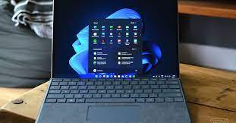
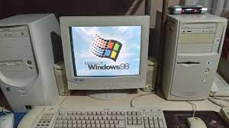
Fourth Generation
(1980-now) The evolution of computers aka operating systems came under the fourth generation. Every user is using their personal computers in this generation.
The concept of personal computers is similar to the minicomputer that was introduced in the third generation.
Today, Windows is the most popular operating system and has evolved from Windows 95, Windows 98. The most used windows operating system was windows 7 and 10. In 2021, windows 11 was introduced with major changes.

Slide 7
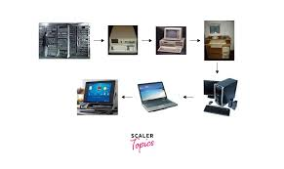

Slide 8
